Slide 1
Uniform Circular Motion

Slide 2
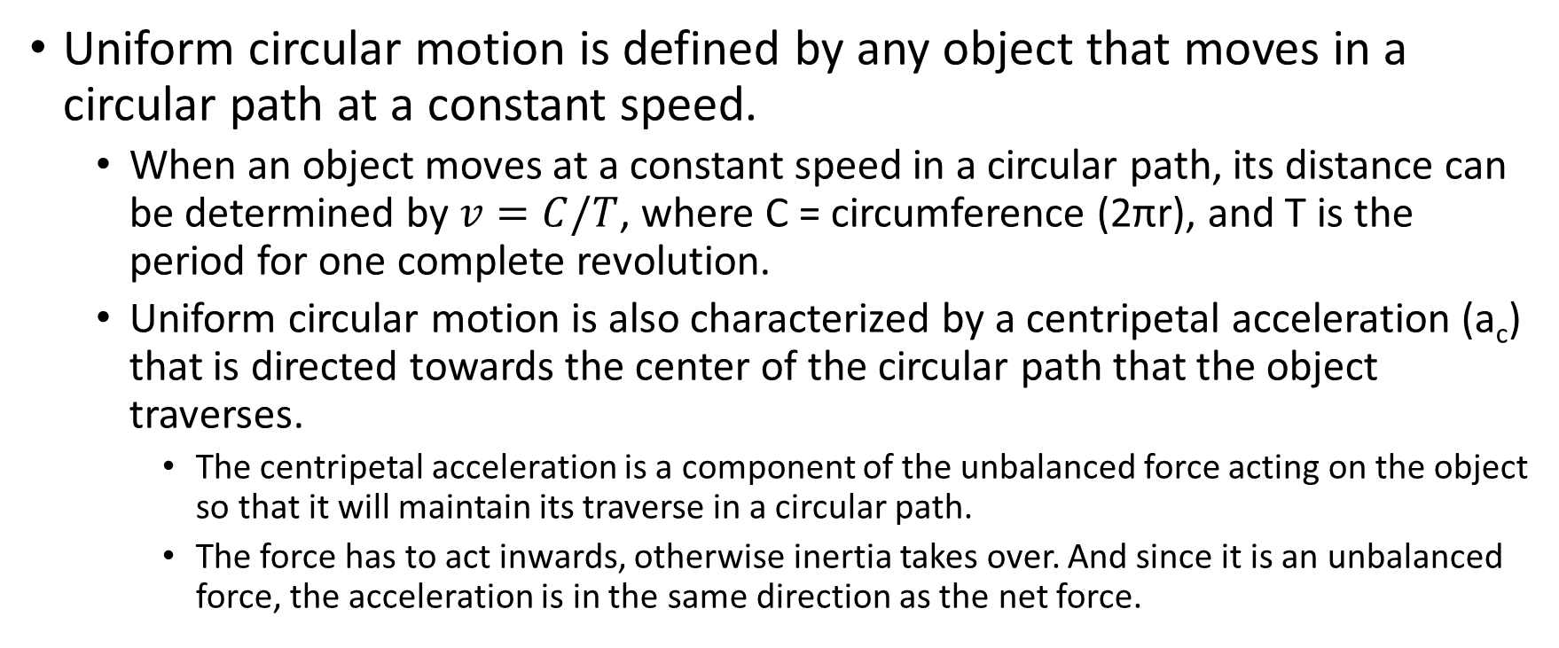
Uniform Circular Motion: What is it?
Uniform circular motion is defined by any object that moves in a circular path at a constant speed.
  When an object moves at a constant speed in a circular path, its distance can be determined by $v=C/T$, where C = circumference (2πr), and T is the period for one complete revolution.
  Uniform circular motion is also characterized by a centripetal acceleration (a_{c}) that is directed towards the center of the circular path that the object traverses.
    The centripetal acceleration is a component of the unbalanced force acting on the object so that it will maintain its traverse in a circular path.
    The force has to act inwards, otherwise inertia takes over. And since it is an unbalanced force, the acceleration is in the same direction as the net force.

Slide 3








Circular Motion – Instantaneous Velocity
For any object moving in a circular path, the velocity vector will always be at right angles to the position vector and tangent to the circle at any given point along the circular path of the object.
$$v2$$
$$v1$$
$$r$$
$$−r1$$
$$r2$$
θ
θ
$$r2$$
$$r1$$
Note that the change in position, $r,$ forms a chord from the tip of r₁ to the tip of r₂.

Slide 4


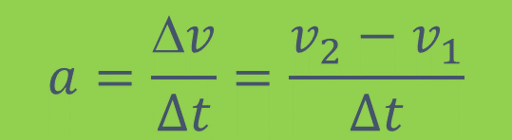






Circular Motion – Centripetal Acceleration (a_{c})
The acceleration of an object moving in a circular path can be represented by a change in velocity per unit of time.
  As a result of the vector subtraction, you will note that the vector $v1$ is inverted before adding to vector $v2$.
  You will also note that the $v$ vector points towards the center of the circular path if placed at the midpoint of the chord that connects both $v1$ and $v2$.
  Since $a=Δv/t$, the vector difference will dictate the direction of the acceleration vector, which for circular motion is towards the center.
$$v2$$
$$v2$$
$$v1$$
θ
$$−v1$$
$$a=\frac{Δv}{∆t}=\frac{v_{2}−v_{1}}{∆t}$$
$$a$$
$$v$$
$$v$$

Slide 5

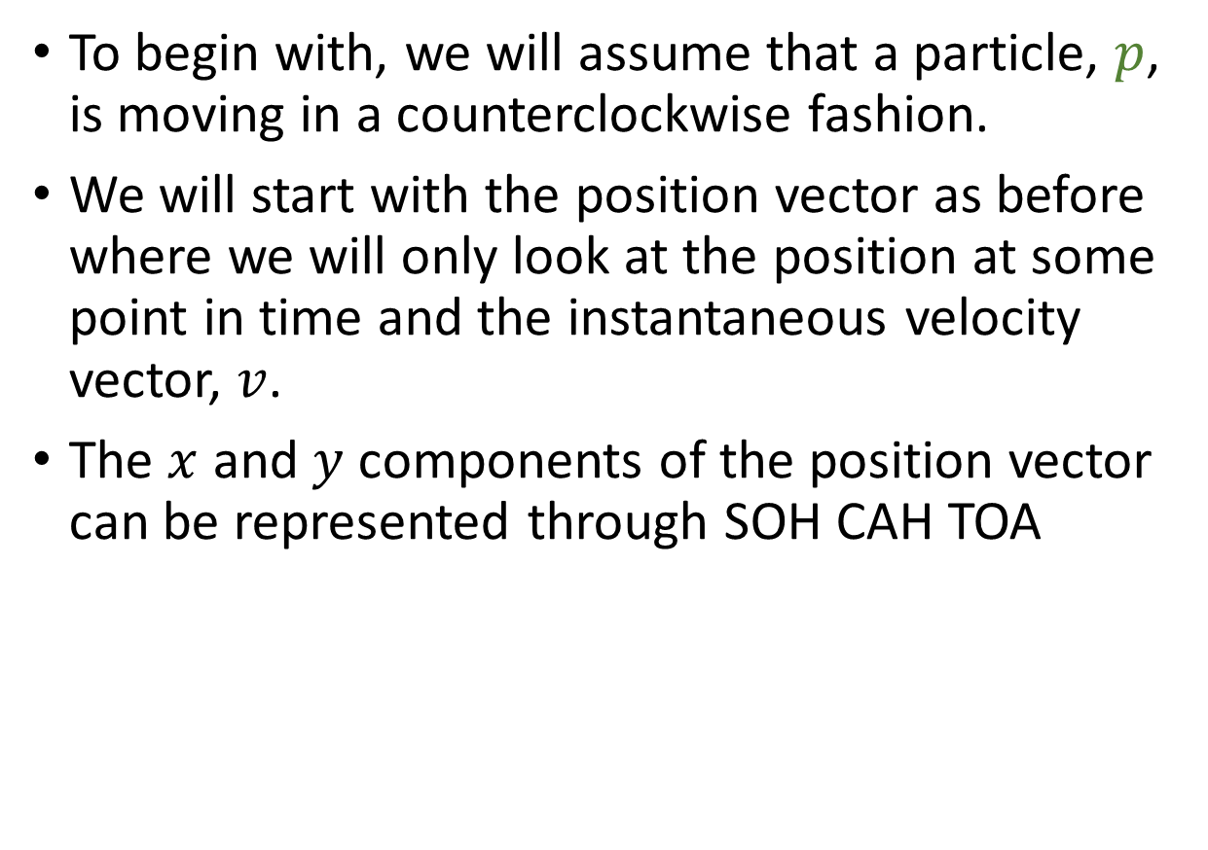









The Proof of why $a_{c}=\frac{v^{2}}{r}$
To begin with, we will assume that a particle, $p$, is moving in a counterclockwise fashion.
We will start with the position vector as before where we will only look at the position at some point in time and the instantaneous velocity vector, $v$.
The $x$ and $y$ components of the position vector can be represented through SOH CAH TOA
$$v$$
$$y$$
$$p$$
$$r$$
$$yp$$
θ
$$x$$
$$xp$$
$sinθ=\frac{y_{p}}{r}$ (1)
$cosθ=\frac{x_{p}}{r}$ (2)

Slide 6
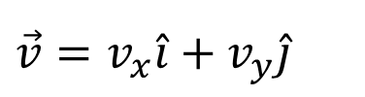
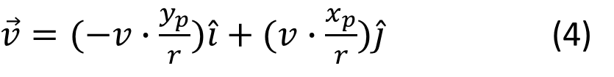
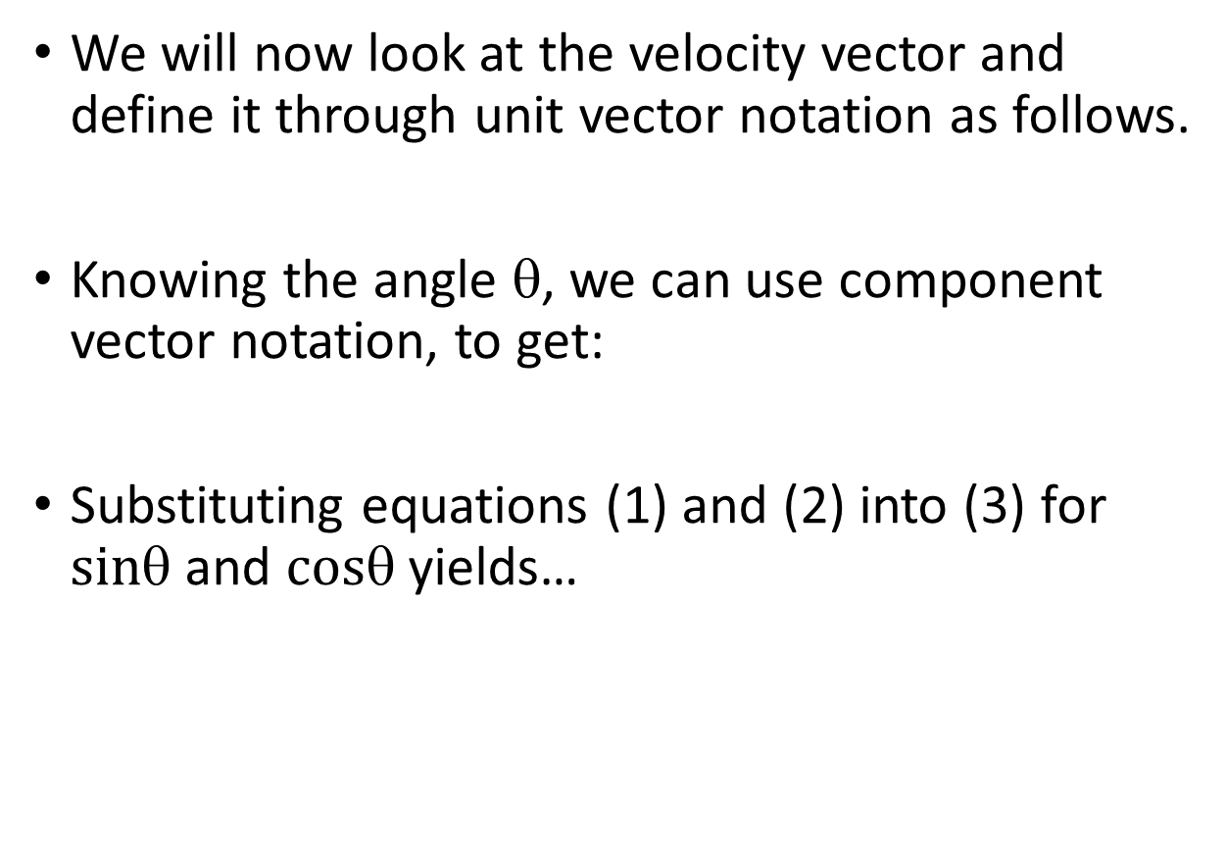

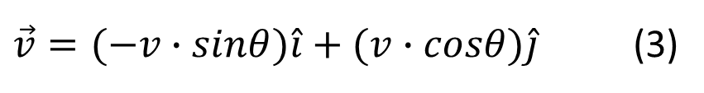






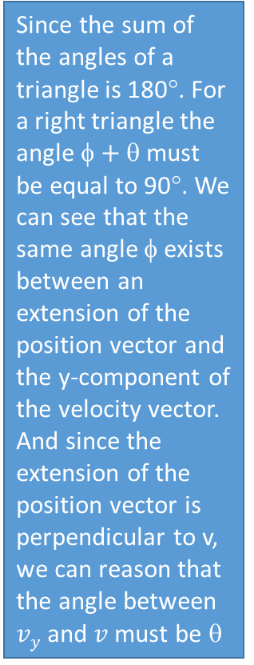
The Proof of why $a_{c}=\frac{v^{2}}{r}$
$sinθ=\frac{y_{p}}{r}$ (1)
$cosθ=\frac{x_{p}}{r}$ (2)
We will now look at the velocity vector and define it through unit vector notation as follows.
Knowing the angle θ, we can use component vector notation, to get:
Substituting equations (1) and (2) into (3) for $sin$ and $cos$ yields…
Since the sum of the angles of a triangle is 180°. For a right triangle the angle $+$must be equal to 90°. We can see that the same angle $$ exists between an extension of the position vector and the y-component of the velocity vector. And since the extension of the position vector is perpendicular to v, we can reason that the angle between $vy$ and $v$ must be θ
$$\vec{v}=v_{x}\hat{i}+v_{y}\hat{j}$$
$${v }_{x}$$
$${v }_{y}$$
$$v$$
φ
θ
$$p$$
$\vec{v}=(−v∙sinθ)\hat{i}+(v∙cosθ)\hat{j}$ (3)
$$r$$
φ
θ
$\vec{v}=(−v∙\frac{y_{p}}{r})\hat{i}+(v∙\frac{x_{p}}{r})\hat{j}$ (4)

Slide 7

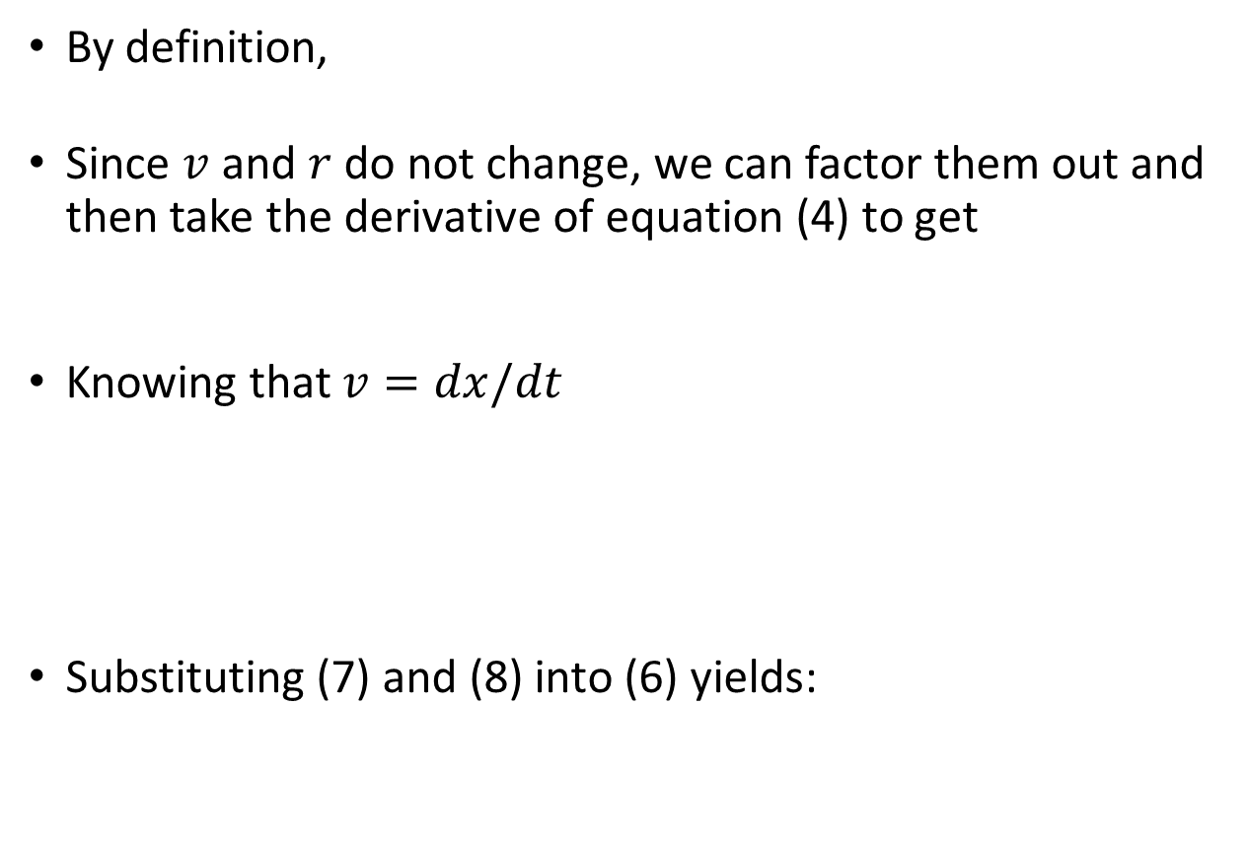








The Proof of why $a_{c}=\frac{v^{2}}{r}$
$\vec{v}=(−v∙\frac{y_{p}}{r})\hat{i}+(v∙\frac{x_{p}}{r})\hat{j}$ (4)
$\vec{a}=\frac{d\vec{v}}{dt}$ (5)
By definition,
Since $v$ and $r$ do not change, we can factor them out and then take the derivative of equation (4) to get
Knowing that $v=dx/dt$
Substituting (7) and (8) into (6) yields:
$${v }_{x}$$
$\vec{a}=\frac{d\vec{v}}{dt}=(\frac{−v}{r}∙\frac{{dy}_{p}}{dt})\hat{i}+(\frac{v}{r}∙\frac{{dx}_{p}}{dt})\hat{j}$ (6)
$${v }_{y}$$
$$v$$
φ
θ
$$p$$
$v_{y}=\frac{{dy}_{p}}{dt}=v∙cosθ$ (7)
$$r$$
φ
θ
$v_{x}=\frac{{dx}_{p}}{dt}=−v∙sinθ$ (8)
$\vec{a}=\frac{d\vec{v}}{dt}=(\frac{−v}{r}∙v∙cosθ)\hat{i}+(\frac{v}{r}∙−v∙sinθ)\hat{j}$ (9)

Slide 8



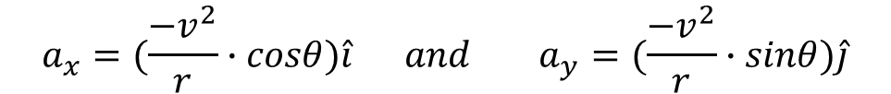


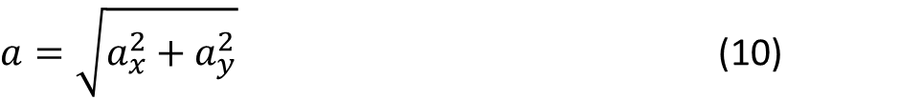





The Proof of why $a_{c}=\frac{v^{2}}{r}$
$\vec{a}=\frac{d\vec{v}}{dt}=(\frac{−v}{r}∙v∙cosθ)\hat{i}+(\frac{v}{r}∙−v∙sinθ)\hat{j}$ (9)
As noted earlier, the acceleration of an object moving in a circular path is towards the center.
We can use the Pythagorean Theorem to obtain the magnitude of the acceleration at point p using the component vectors:
By inspection of equation (9) and some simplification
Rewritten…
$$y$$
$${a }_{x}$$
$$p$$
$a=\sqrt{a_{x}^{2}+a_{y}^{2}}$ (10)
$$a$$
$${a }_{y}$$
ϕ
$$x$$
$\vec{a}=\frac{d\vec{v}}{dt}=(\frac{−v}{r}∙v∙cosθ)\hat{i}+(\frac{v}{r}∙−v∙sinθ)\hat{j}$ (9)
$\vec{a}=\frac{d\vec{v}}{dt}=(\frac{−v^{2}}{r}∙cosθ)\hat{i}+(\frac{−v^{2}}{r}∙sinθ)\hat{j}$ (9a)
$${a }_{x}$$
$${a }_{y}$$
$$a_{x}=(\frac{−v^{2}}{r}∙cosθ)\hat{i} and{ a}_{y}=(\frac{−v^{2}}{r}∙sinθ)\hat{j}$$

Slide 9


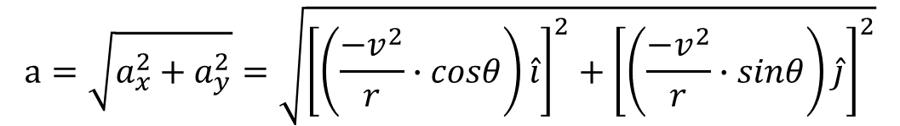





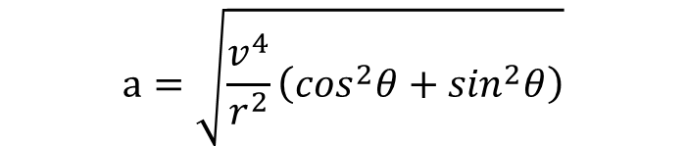

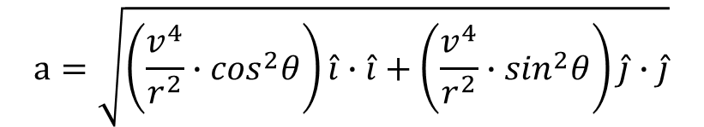

The Proof of why $a_{c}=\frac{v^{2}}{r}$
$$a_{x}=(\frac{−v^{2}}{r}∙cosθ)\hat{i}$$
$$a_{y}=(\frac{−v^{2}}{r}∙sinθ)\hat{j}$$
Substituting into (10) yields:
Performing a little algebra leads to…
We will now factor out $\frac{v^{4}}{r^{2}}$, and note that $\hat{i}∙\hat{i}$ and $\hat{j}∙\hat{j}$ both equal 1, which gives us.
Our trig identities tells us that $\cos^{2}θ+\sin^{2}θ=1$, which leads us to:
$$a=\sqrt{a_{x}^{2}+a_{y}^{2}}=\sqrt{{\left[\left(\frac{−v^{2}}{r}∙cosθ\right)\hat{i}\right]}^{2}+{\left[\left(\frac{−v^{2}}{r}∙sinθ\right)\hat{j}\right]}^{2}}$$
$${a }_{x}$$
$$p$$
$$a=\sqrt{\left(\frac{v^{4}}{r^{2}}∙\cos^{2}θ\right)\hat{i}∙\hat{i}+\left(\frac{v^{4}}{r^{2}}∙\sin^{2}θ\right)\hat{j}∙\hat{j}}$$
ϕ
$${a }_{y}$$
$$a$$
$$a=\sqrt{\frac{v^{4}}{r^{2}}\left(\cos^{2}θ+\sin^{2}θ\right)}$$
$$a=\sqrt{\frac{v^{4}}{r^{2}}\left(1\right)}$$
$$a=\frac{v^{2}}{r}$$
Proven!
Which simplifies to…

Slide 10




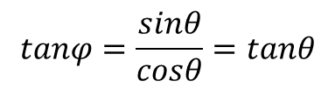



The Proof of why $a_{c}=\frac{v^{2}}{r}$
The last part of this proof is to show that $=.$
  By inspection of the vector arrangement, we can see that
  Substituting for $ax$ and $ay$ gives us.
  With some simplification we get…:
  It becomes clear that ϕ must be the same as θ!
$$tanφ=\frac{a_{y}}{a_{x}}$$
$${a }_{x}$$
$$p$$
$$tanφ=\frac{\frac{−v^{2}}{r}∙sinθ}{\frac{−v^{2}}{r}∙cosθ}$$
ϕ
$${a }_{y}$$
θ
$$a$$
$$tanφ=\frac{sinθ}{cosθ}=tanθ$$

